Slide 1

Welcome to Social Media 101: Real Estate

Slide 2



Social Media Training Seminar
GOAL: Learn how to more effectively use Facebook, LinkedIn, and Twitter to help build your business
Define
Recognize
Discuss
Identify
Apply
Differentiate
Establish

Slide 3


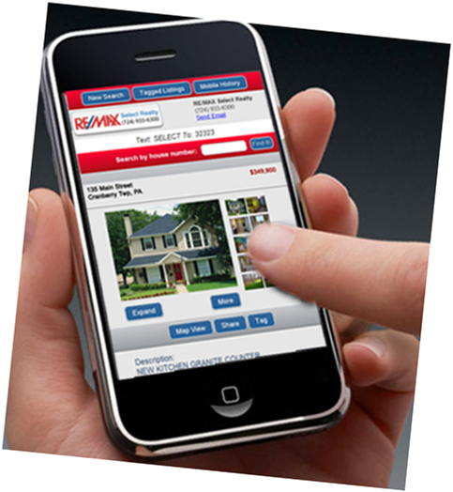
Social Media Training Seminar
Presentation (1 hour)
Workshop / Q&A
  Social media trends
  Tips
  Facebook, Twitter, LinkedIn
  Do’s & Don’ts of Social Media marketing
  Allows time for questions & individual attention
  Get on devices-- laptops/smartphones/tablets & play with social media accounts

Slide 4




What is Social Media?

Slide 5







Social Media + Real Estate
Why is Social Media relevant to Real Estate?

Slide 6

Social Media + Real Estate
  Digital Age: DON’T GET LEFT BEHIND
“Its not the strongest species that survive, nor the most intelligent, but the one who is most responsive to change.”
  ~Charles Darwin

Slide 7
Social Media + Real Estate
Most efficient forms of Social Media for real estate agents
Source: http://realestate.imforza.com

Slide 8

Social Media Do’s & Don’ts
Do’s
  Social Listening
  Make Connections
  Interact positively
  Watch competitors/peers pages
  Watch relevant pages to your area
  Be Creative
  EXPERIMENT
Don’ts
  Interact negatively
  Copy your competitors accounts
  Post too much – BALANCE IS KEY
  Rely only on Social Media
  Best times to post: Morning & Late afternoon

Slide 9


Facebook
What are you doing on Facebook?
What do you think you could be doing better on Facebook?

Slide 10
Facebook Tips
TIPS
  CREATE A PROFESSIONAL BUSINESS PAGE
      - Separates your personal life from your professional life
      - Easy to manage (manage directly from personal page)
      - Come up in Google searches – SEO Optimization!
      - Track your online insights – traffic, engagement, etc.
      - Can reach larger audiences
    Why?

Slide 11





Facebook tips continued..
BUILD YOUR BRAND
      - Online Presence
      - Professional head shots, Logos, slogans, etc.
    SHARE YOUR PAGE
      - Friends
      - Family,
      - RE/MAX Select Realty Clients
      - Consider-- Pay to boost, etc.
    Why SHARE and not just LIKE ?

Slide 12





SHARE vs. LIKE!!
    Regular post: Reach – 48 people
    SHARED post: Reach – 704 people
Goal = REACH more people
If 3 people share this post…
SHARE
SHARE
SHARE
A much larger audience will be reached!!

Slide 13
Facebook Tips Continued..
WHAT TO POST
    - Promote!!! Promote yourself and your business (it is okay to brag a little)
    Make it professional & engaging, but most importantly,
    MAKE IT YOUR OWN!
Listings
SelectHomeFinder.com
Open Houses
Upcoming
Events
Pictures &
Videos
Industry News
Locally Relevent Info
Keep it Positive!

Slide 14
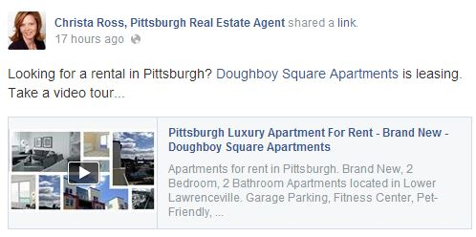



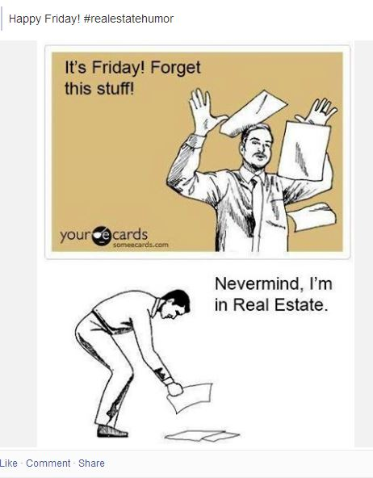
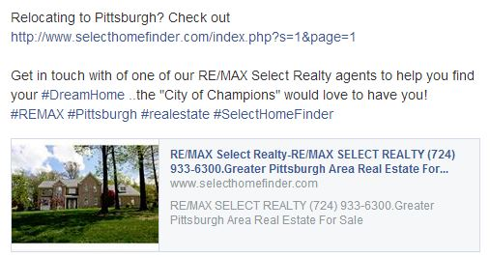
Facebook Tips Continued

Slide 15
Facebook
Other considerations
  Have patience
  Be persistent & consistent
  Don’t be afraid to ask people to Like & Share your page
  Put your social media pages on marketing materials
  Download Mobile app to post anywhere, at any time
  Use this as a source of information about your consumers- research & listen to what they are saying

Slide 16
Facebook Do’s & Don’ts
Do
  Consistent Activity (Daily)
  Like other relevant pages
  Keep track of your traffic/insights
  Watch competitors/peers pages
  Add pictures & videos
  80/20 rule
  Use your personal touch
Don’ts
  Like your competitor’s pages
  Keep it only about your brand
  Like every page you come across- use discretion

Slide 17



Any Questions about Facebook?

Slide 18
LinkedIn
What are you doing on LinkedIn?
What do you think you could be doing better on LinkedIn?

Slide 19

LinkedIn
World’s largest Professional Network
Great for making professional connections, promoting yourself, and your success

Slide 20
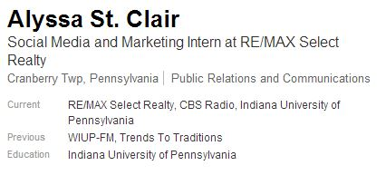

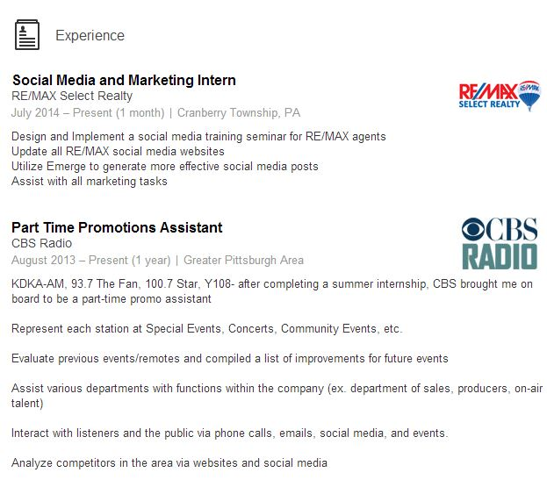
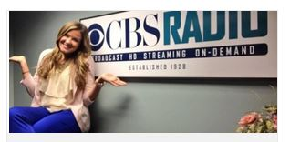
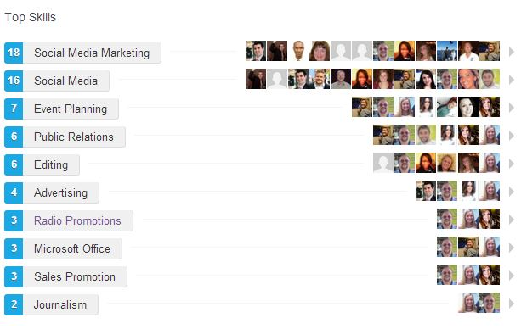
LinkedIn Tips
INCLUDE ON PROFILE
  A profile photo
  The industry you work in
  Images/logos
  A detailed Resume
  Your Skills

Slide 21





LinkedIn Tips Continued..
Include key words: “real estate, agent, RE/MAX”
Join relevant groups- RE/MAX groups, Real Estate groups, etc.
Include your education and any designations

Slide 22
LinkedIn
Other considerations
  Easy to maintain, you don’t need to post everyday
  Download the mobile app to post anywhere, anytime
  Make as many connections as possible, you never know what it could lead to

Slide 23
Linked In: Do’s & Don’ts
Do’s
  Make as many connections as possible
  Keep it professional
  Keep it clean/simple
  Post once a week
  Post any awards
  Share relevant blogs
Don’ts
  Deny any friend requests
  Add snapshots of you with other people
  Add irrelevant information
  Post your listings/open houses
  Post anything personal
  Post everyday

Slide 24


Any Questions about LinkedIn?

Slide 25

Twitter
What are you doing on Twitter?
What do you think you could be doing better on Twitter?

Slide 26

Twitter
Microblogging service that enables users to send and read short 140-character text messages, called "tweets".
Pump messages out to followers through tweets, retweets, and replies
Gain information by following relevant accounts

Slide 27
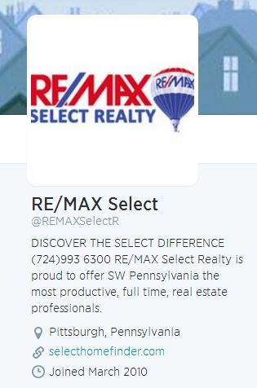
Twitter Tips
Build your brand
  Logos, slogans
Fill your page with important information
  Job history, location, email, phone number, etc.

Slide 28



Twitter Tips
  What is a HASHTAG?
- Use relevant hashtags to increase your traffic
  What is a Trending Topic?
  - Ex: #REMAX #Pittsburgh #RealEstate #SelectHomeFinder
Use links to drive traffic to websites
  SelectHomeFinder.com
  Any personal websites / professional facebook page

Slide 29

Twitter Tips
Post pictures & videos
  Listing tours
  Happy home buyers
Be creative and engaging
  Don’t just post listings
  Add your own personal touch
  80/20 Rule

Slide 30


Twitter: Do’s & Don’ts
Do’s
  Keep your profile public
  Tweet daily (2-7 times)
  Follow relevant accounts
  Let everyone but SPAM accounts follow you
  Retweet relevant accounts (ex.) Pittsburgh News Accounts, blogs, etc
  80/20 Rule
Don’ts
  Follow irrelevant accounts
  Follow your competitors
  Keep it only about your brand

Slide 31





Any Questions About Twitter?

Slide 32
Any Questions??

Slide 33




Social Media Workshop
Facebook.com
Linkedin.com
Twitter.com

